Slide 1
IFAI DLA Product Test Center Analytical Shade and Source Procedures
May 5, 2021

Slide 2
Overview
Background – How did we get here?
Shade Procedures- Art and Science and a Lot of Hard Work
Testing
Terminology – What does DLA Troop Support expect?
Contractual Obligation – Why should we care
General Procedures – How it all works
New Technology-
Source:

Slide 3
Product Test Center Analytical History
What Has Happened In the Last 102 years!
Lab established in 1919 at Philadelphia QM Depot where testing was for paints and oils
By 1927 the mission refocused to test textiles, rubber, shoes, metals, leather and paper for strength and colorfastness, and other physical and chemical testing.
In 1941 a new building was constructed, and served as a focal point for R&D and testing of textile materials
In 1946 the lab was used by the QM Inspection service for sample testing
In the 1950’s the lab tested thermal properties on cold weather gear for Korea, and worked to develop a water-repellant shoe method, along with anti fungal research on tropical textile goods.
In 1953 the R&D work moved to Natick, and the Philadelphia lab became a conformance laboratory.
In the 1970’s DPSC’s Analytical Testing Laboratory became a member of the DLA’s Independent Laboratory Testing Team, and was able to offer its testing services to other government agencies in all types of chemical and physical analysis
From 1996 to 2017 we were part of al all PTC directorate under Land & Maritime, now part of Troop Support
The PTC-Analytical is available to support all of Troop Support’s supply chains and other MSC’s, service partners, and outside government agencies.
We are here to help with all of your testing needs (there are a lot of them)!
Notes:
The PTC’s main concern and work over the years has focused on supporting the warfighter through conformance testing. Along with supporting the MSCs we also support the services, WoG, and are able to test for non-government contractors

Slide 4
PTC-A Value Added
Value Of Testing
Ensures Product Conformance
Mitigates the Risk of Counterfeit goods entering Supply Chains
Reduces Customer Complaints
Reduces Material Cost / Identifies Questionable Sources
Advantages of the PTC
Test and support to DLA customers is non-reimbursable
Integrated into overall TQ program
Studies demonstrate best value to the agency
Record of excellent support throughout DLA
Our Lab is ISO Registered, ISO 9001-2015
Provide Professional and Cost Effective Testing Services
Notes:
Our purpose as a testing facility is of course to provide professional and cost effective testing services. Through our work in all labs we strive to stay on the cutting edge, and be aware of new advances in testing. New equipment, and training are planned well in advance of items moved to DLA for sustainment.

Slide 5
Shade Procedures
How do you know if you are required to send samples to the PTC-A for shade evaluation?
How many samples?
Where do the samples go?
Who picks the samples?
What needs to come with the samples?
What happens when the samples show up?
Who is evaluating the samples?
How do they evaluate?
Paperwork, why is there always paperwork?

Slide 6
Shade Procedures
How do you know if you are required to send samples to the PTC-A for shade evaluation?
It’s right in your contract!
SHADE EVALUATION OF CONTRACTOR FURNISHED COMPONENTS
Contracts awarded under this solicitation shall require shade evaluation of Contractor furnished components in accordance with the following
provisions:
(a) Swatches shall be cut by the Contractor from those pieces or rolls selected by the Government representative. For yard goods, the
dimensions of each swatch shall be 4" x 12" while for narrow loom material each swatch shall be a full width and 12" in length. The number
of pieces or rolls to be sampled shall be in accordance with the following table:
Lot Size Pieces to be sampled
1 to 8 pieces Each piece
9 to 25 pieces 8 pieces
26 to 90 pieces 20 pieces
91 to 160 pieces 32 pieces
over 160 pieces 1 of 5 pieces
(b) The swatches shall be submitted to the Government laboratory for shade evaluation. If any swatches are rejected, the end items made from the rejected component lot shall also be rejected.
In these instances, the Contractor shall without cost to the Government, cut additional shade swatches from each remaining piece or roll in the rejected sample lot which was not previously sampled and submit these swatches to the Government for shade evaluation.
(c) Swatches submitted in accordance with (a) and (b) above, shall also be evaluated for uniformity of shade when so specified in section 3 of the fabric specification and when the standard sample is referenced for uniformity of shade.
Notes:
The prime contract will have a clause that directs shade evaluation. This will state random if the sampling is random or 100%. Updates have been made to the quality provisions that allow a supplier representative to pull sample if a QAR is not available.

Slide 7
Shade Procedures
How Many Samples?
SHADE EVALUATION
[] (a) 100% Swatching: From each piece in the lot, the Contractor shall cut a 4 X 24 inches shade swatch which is representative of the
shade of the piece. The Contractor shall cut these swatches into two 4 X 12 inches swatches and identify each swatch with the piece from
which it was cut. One set of swatches and a tally list of piece numbers for each roll of the lot shall be forwarded to the DLA Product Testing
Center Analytical for evaluation. The remaining set shall be retained at the plant for use by the Quality Assurance Representative (QAR).
or
[ ] (a) Sampling: Notwithstanding any current provisions of the fabric specification, the following shade evaluation shall apply to this
solicitation. A 4 x 12 inches shade swatch will be cut by the Contractor from those pieces or rolls selected by the Government representative,
in accordance with the following table:
Lot Size Number of Pieces to be Sampled
1 to 8 pieces Each piece
9 to 25 pieces 8 pieces
26 to 90 pieces 20 pieces
91 to 160 pieces 32 pieces
over 160 pieces 1 of 5 pieces
The swatches shall be identified and submitted to the DLA Product Testing Center--Analytical for shade evaluation.
If one or more of the shade swatches submitted are found unacceptable, the entire lot shall be rejected. A lot that was rejected for shade shall be screened and all pieces in the lot defective for shade shall be removed before such a lot is resubmitted. Resubmitted lots shall again be subjected to the sampling and shade evaluation prescribed herein. This requirement does not negate the Contractor's responsibility to perform shade evaluation prior to submittal of a lot to the Government. (b) When Section 3 of the fabric specification contains a specific requirement for uniformity of shade and when the standard sample is
referenced for uniformity of shade, the swatches submitted in accordance with (a) above shall also be evaluated for uniformity of shade.

Slide 8
Shade Procedures
Who Chooses The Samples?
In the old days (before 2019) DCAM had a QAR in every plant.
Some were resident and some were transient, making visits once a week or every other week.
DCMA pulled a majority of QARS out of the plants.
DLA contracts with delivery orders under $300,000 will not have a QAR
DLA has recognized this, and now allows for a SSSR, a supplier’s source sampling representative
They should pull samples in the same way as a QAR, randomly, and make sure all quality provisions are met.

Slide 9
Shade Procedures
Where do the samples go?
The Contractor shall transmit the swatches to:
DLA Product Testing Center-Analytical
700 Robbins Avenue
Attn: Bldg. 5
Philadelphia, Pennsylvania 19111-5092
The DD1222 shall indicate "For Government shade approval" and contain the following information:
(1) Name of prime Contractor.
(2) Contract number.
(3) Nomenclature.
(4) Government inspection lot number.
(5) Number of swatches being submitted.
(6) QAR's name/ SSSR Name.
(7) Name of the QAR’s/SSSR’s base plant.
(8) Piece number of standard sample cited in contract.
(9) Tally list with piece numbers
Notes:
If your samples are evaluated at 100% (sample from every roll in the lot) and a sample fails shade, the roll will be listed. You can pull that roll and ship the rest of the lot. You can still ask for a waiver for that roll. In random sampling if a roll fails the entire lot fails. The component manufacturer has the ability to sort and resample. All failed rolls are pulled, and from the remaining rolls random samples are again pulled. This lot can be resent for shade evaluation under the same lot number with an X So lot 11, would become lot 11X with roll and yardage updates.

Slide 10
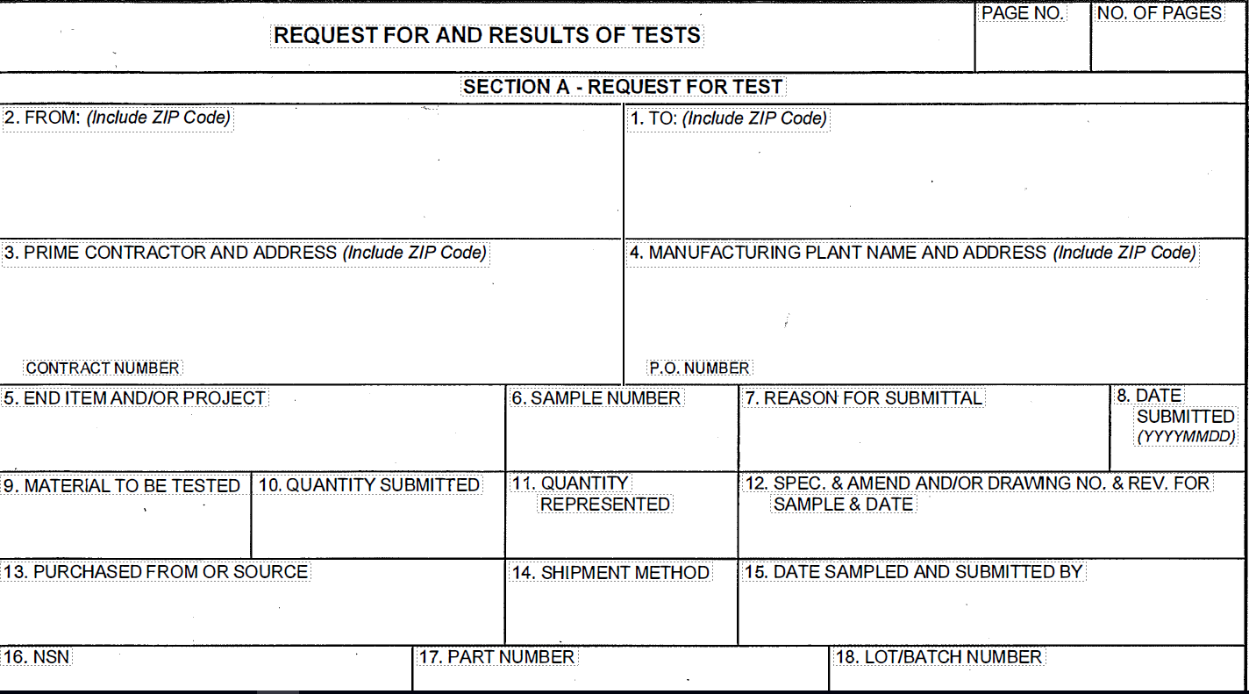
What Needs to Come with the Samples?
Test reports must list:
1. The total quantity in lot represented by the samples present
Section A
Box 2 – From (Finishing Plant DCMA QAS or SSSR information)
Box 1 – To (DLA Product Test Center, 700 Robbins St, Bldg. 5D, Philadelphia, PA 19111)
Box 3 – Prime Contractor and contract number
street address and ZIP code NOT REQUIRED
Box 4 – Manufacturing Plant and P.O. Number street address and ZIP code NOT REQUIRED
P.O. Number is optional

Slide 11
What Needs to Come with the Samples?
Box 5 – End Item (ex: MCCUU Woodland Blouse, Type I, Class 3)
Use terms from the specification or purchase description
Box 6 – Sample No.
Vendor’s choice – use this field as you wish
Box 7 – Reason for submittal (possible entries below)
Shade Evaluation
Box 8 – Date Submitted
Date samples selected
Box 9 – Material to be tested (MCCUU Cloth, Type I, Class 2)
Cloth, Nylon/Cotton Ripstop
Use the terms from the specification or purchase description
Do not use vendor specific trade names
Box 10 – Quantity submitted
number of samples/garments tested
sample size

Slide 12
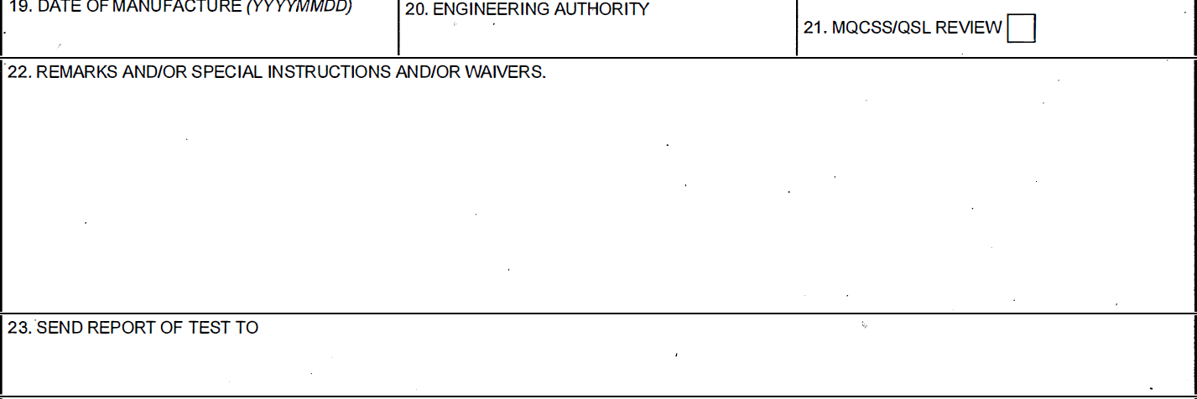
What Needs to Come with the Samples?
Box 19 – Date of Manufacture
Optional
Box 20 – Engineering Authority
Does not apply
Box 21 – MQSS/QSL Review
Does not apply
Box 22 – Remarks and/or special instructions and/or waivers
Add “By signing in box 15, I certify that the samples referenced above were randomly selected and represent the lot identified above.”
Record shade
Record shade standard roll#
Record rolls selected for testing (may indicate on a separate tally sheet)
Do not completely fill this box. The DLA PTC uses it for processing.
Box 23 – Send report of test to
Include prime contractor and supplier email addresses
Shade and will automatically be sent directly to contractors on completion.

Slide 13
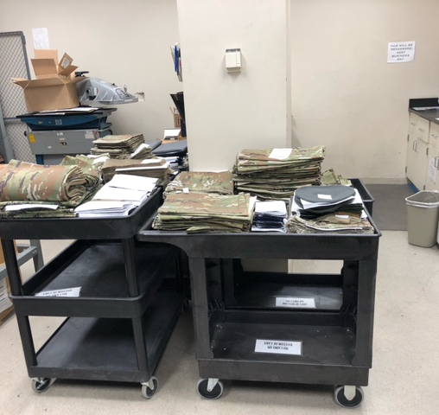
What Happens When The Samples Show Up?
Sample Room
Samples accepted in our sample room
The DD 1222’s are stamped with the PTC’s Lab Report Number (LRN)
Logged into our Database for tracking
Put on carts to be pushed to the Shade room
On any given day we can see from 20 to 100 different lots

Slide 14
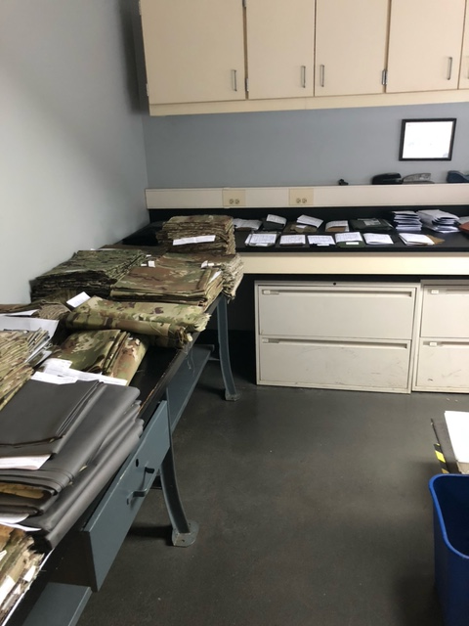
Shade Room Delivery
All PTC Associates do all of their own paperwork
Samples are delivered to the shade room
The clock starts when the samples are logged into our database.
Expect the entire process to take up to 4 business days
Contractually we have 30 days, but we never use them
Samples are separated by type, class and color
All DD 1222’s are checked for correct information
If not correct someone will contact you for an updated DD 1222
Tally sheets checked to match roll numbers

Slide 15
Who Is Evaluating Your Samples
Color Science At DLA
The Shade Room is manned by members of the PTC who:
Have a degree in Chemistry, or Engineering
Have passed both an initial color vision test, and scored in the superior range on the Farnworth-Munsell 100 Hue Color Test
A year of training with the senior color scientist
Right now, Uraina Gray-Scully, and Brittany Gallagher are your color scientists.
Andrew Gabriele is in training
I cover down for vacations, and worked in the shade room for over 20 years.

Slide 16
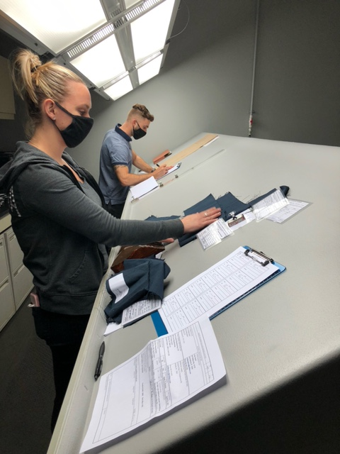
How to we evaluate?
100% visual evaluation for acceptance
AATCC Evaluation procedure 9 Option C (before 2019 it was Option A)
D7500 +/- 200 D Kelvin at 100 +/- 20 ft primary, INC A for metamerism check, Whites also evaluated under UV
Standard is cited in the contract
Tolerance ranges are developed from production lots

Slide 17
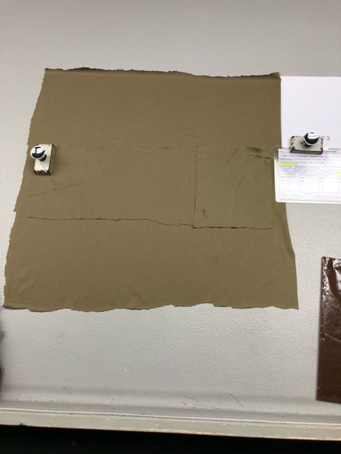
Passing Samples
When your submission passes
Once evaluated, passing samples are discarded
In section B of the DD 1222 the evaluator will date, and sign a passing report.
The block where we capture our results will say Passing
There may be a limit attached
Red Limit, Full Limit, Thin Limit, Blue Limit
This is in regard to the standard and tolerances
Once a passing report is received, lot may ship

Slide 18
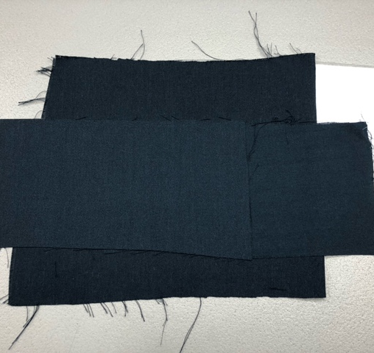
Failing Shade Samples
When you submission fails
If samples fail, it will be marked on the DD 1222 as failing. Too full, too red and so on
Either the entire lot, or individual samples will fail
If individual samples fail, the roll that fails will be written on the DD 1222, and the shade room communicates with the C&T QA the severity of the failure
At this point a contract has a few options
Ask the contracting officer for a waiver. This is not an automatic process.
Resort and resubmit. Pull the failing pieces out of the lot, represent the lot to the QAR or SSSR, and submit with a new DD 1222
The new DD 1222 should have the yardage adjusted to reflect the pieces taken out, and the lot should be the same with an X, so lot 22 becomes lot 22x
If this was 100% sampling, failing rolls should be pulled, and the rest of the lot can ship.

Slide 19
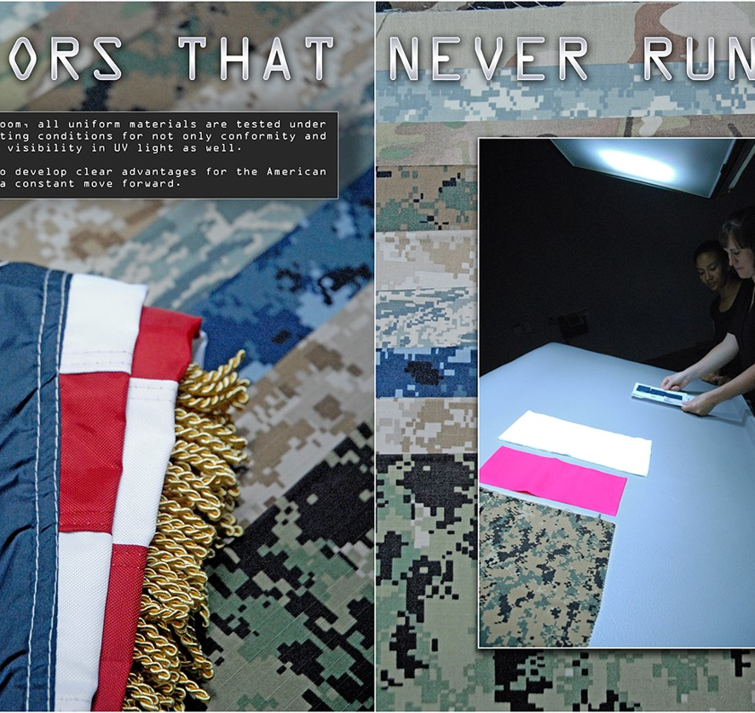
Paperwork
The world turns on paperwork, even if its electronic
Reports are emailed out to the distribution list, including, prime, sub, C&T QA, and anyone included in the DD 1222
On our website you can find a copy of the AQAR, and an E copy of the DD 1222.
If you are interested in instrumental values for contractual shade standards, and non-contractual tolerance ranges you will also find that information on this site.
https://www.dla.mil/TroopSupport/ProductTestCenter

Slide 20
The AQAR Is Your Friend!
AQAR: The DLA Troop Support Clothing & Textiles Additional Quality Assurance Requirements
The AQAR serves multiple purposes for DLA
It allows us to have oversite into our vendors quality process without having to be present in their manufacturing plants
Quality process and quality goods are something that DLA is purchasing along with the cloth, buttons, boots, helmets and anything else the warfighter wears or carries. All contractors should be in compliance.
For every shade lot there should be a corresponding physical testing report
If lots are broken down for shade sorting only one physical test report is required
This type of compliance can be audited.
Notes:
Vendors seem to pay more attention to the clauses that control shade evaluation. We believe that this is because they cannot ship on their own results. The physical testing reports are being neglected.

Slide 21
Background
1980s
1991
1990s
2002
2010s
Source Sampling Program begins
Government reviews test reports
No regular verification schedule
Contractor’s test results primary
Goal → Reduce contractor’s delayed shipments
Source:
Notes:
In 1991 the source sampling era began, contractors were able to ship on their own test reports, reducing backorders.

Slide 22
Background
1980s
1991
1990s
2002
2010s
Clothing & Textiles asks the Product Test Center to take over the Source Sampling Program
DPSCM 4155.3 and contracts not updated to reflect change
2018 DPSCM 4155.3 updated to AQAR
Source Sampling MOA between C&T and PTC signed in 2019
Source:
Notes:
C&T’s delegation of the source sampling program to the PTC was not documented until 2019.

Slide 23
10,000 ft View
Request
Place(s) of Performance
Laboratory Certification
Lot
Notification
SSSR
selects samples
Within 90 days the test report is sent to the DLA PTC
SSSR signs and dates DD1222
Testing complete
Test Report Evaluation
Shade Evaluation
PRIME
SUBCONTRACTOR
PRODUCT TEST CENTER
Source:

Slide 24
Source Sampling
Testing is conducted on the finished cloth at the source, prior to manufacturing the end item.
May include end items.
A test report and signed DD 1222 must be sent to the DLA PTC for every lot.
DLA PTC and DCMA are C&T’s performance eyes and ears.
Source:
Notes:
DCMA are in the plants when there is a delivery order over $300,000, when under the AQAR has been updated to reflect that the Suppliers Source Sampling Representative can do the job that the QAR was doing. For contracts under $100,000 a CoC can be accepted in lieu of test reports.

Slide 25
Physical Testing/ Source Sampling
FOR physical (non-shade) testing: in accordance with clause 52.246-9032, the contractor's approved qualified laboratory will be required to forward a completed test report for each lot of components to the address below. The QAR or SSQR will forward the completed dd form 1222.
Samples for physical testing will only be forwarded upon request to:
DLA Product Testing Center Analytical
700 Robbins Avenue
Philadelphia, PA 19111
ATTN: BLDG 5D
EMAIL: paactlab@dla.mil
PHONE: 215-737-3298
THE USE OF ELECTRONIC SUBMISSION OF DD FORM 1222 IS AUTHORIZED.

Slide 26
Correlation Testing
DLA PTC tests the same material that the contractor has tested, and results from both labs are compared.
Not automatic. Must be requested by DLA PTC representative.
DLA PTC will alert C&T product specialist to any discrepancies between the two reports.
Material ships to end item manufacturer based on Contractor’s passing test report.
Source:

Slide 27
Verification Testing
DLA PTC tests the same material that the contractor has tested, and results from both labs are compared.
Requested by C&T product specialist via DL6004 or contract mod.
May involve 100% testing, or only tests of interest.
Material only ships to end item manufacturer based on DLA PTC’s passing test report.
Source:

Slide 28
Acceptance Testing
100% Verification Testing for every lot of a contract.
Shade Testing
  Color and Appearance
NIR Testing
  near Infrared Reflectance Testing (Spectral Reflectance)
Critical Safety Items
Source:

Slide 29
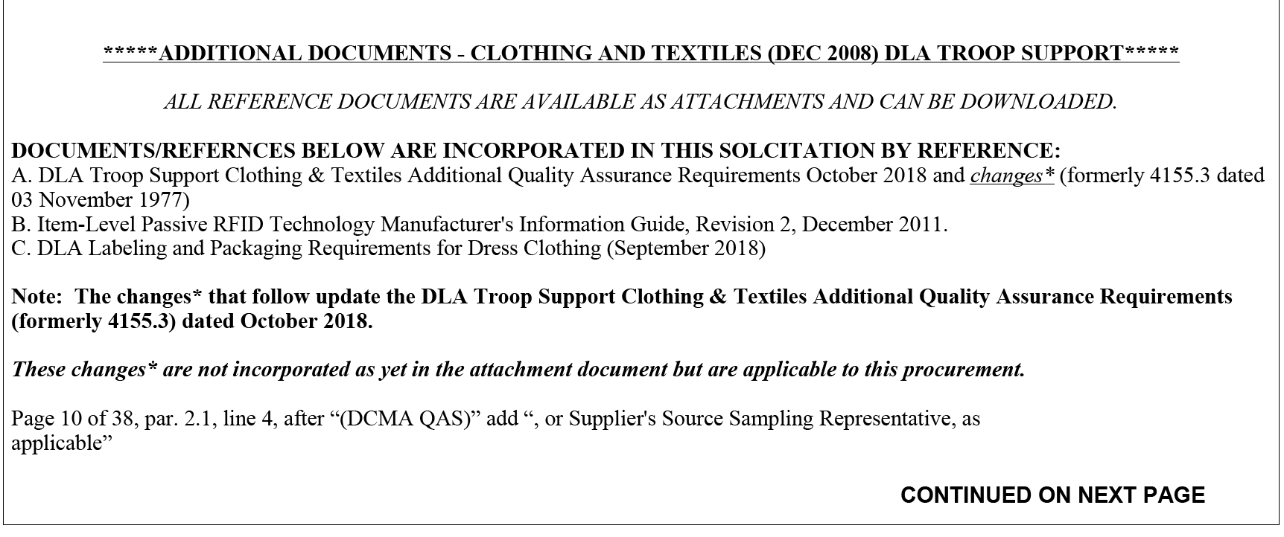
Contractual Obligation
Source:

Slide 30
Contractual Obligation
Old DLAD clause cancelled – could be found in Section I – Contract Clauses
E46C12 52.246-9032 IDENTIFICATION OF QUALIFIED LABORATORY AND SOURCE SAMPLING (NOV 2011) DLAD
Lab Certification Program (Lab Surveys)
(a) The offeror or bidder shall indicate in paragraph (e) below the name and address of the laboratory or laboratories where components or end items will be tested during the course of any resultant contract. Any laboratory proposed by the contractor is subject to the approval of the contracting officer.
Source:

Slide 31
Contractual Obligation
QAR Responsibilities and Correlation Testing
(b) The Government QAR will cut samples from a lot at the textile component source and send them for testing to the Laboratory cited below. (The acceptability of each lot will be determined through the testing of these samples). In addition, the QAR will simultaneously cut samples from the same rolls of material and send them to the DLA Troop Support laboratory when advised by the DLA Troop Support textile technologist to do so. For end items, duplicate samples will be drawn. Source sampling procedures are detailed further in the DLA Troop Support Clothing & Textiles Additional Quality Assurance Requirements dated October 2018 (formerly 4155.3, dated 03 November 1997), which is incorporated by reference.
Updates to AQAR permit the
Supplier’s Source Sampling Representative to cut samples.

Slide 32
Contractual Obligation
Notifications – to the DLA PTC
(c) The prime contractor will notify the DLA Troop Support textile technologist (__________ at (215) 737-____) in writing at least ten days in advance when lots are to be presented to allow Government witnessing of testing at the contractor’s laboratory. If the Government intends to witness testing, a representative from the DLA Troop Support laboratory will notify the contractor’s laboratory. In the absence of Government notification, testing should proceed as scheduled.
What if a lab cannot be approved and DLA needs the goods?
(d) Should the contracting officer withdraw approval of the laboratory proposed by the contractor during the course of a contract, DLA Troop Support will perform the required testing for up to 30 calendar days from the date of approval withdrawal. The charge for testing will be at the DLA Troop Support laboratory’s effective cost rate on the date of testing. The contractor is responsible for securing the services of another laboratory during this period.
Notes:
Note: In plain English, notifications are to go to the DLA Product Test Center – Analytical. We have either textile technologists or chemists assigned to each laboratory. Send notifications to paactlab@dla.mil. We will then assign that laboratory a lab specialist to handle test reports.

Slide 33
Who do notifications go to
In plain English, notifications are to go to the DLA Product Test Center – Analytical
We have either textile technologists or chemists assigned to each laboratory.
Send notifications to paactlab@dla.mil.
We will then assign that laboratory a lab specialist to handle test reports.
Please check your contracts to make sure your test reports are being sent to the PTC-A

Slide 34
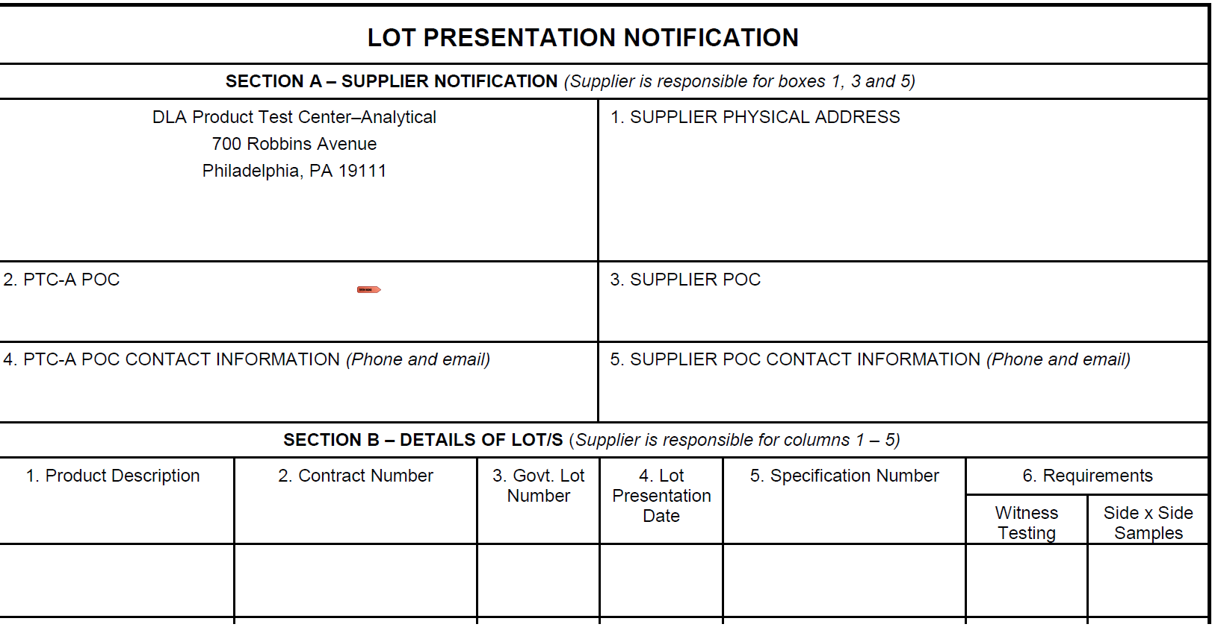
Notification of Lot Presentation
Minimum 14 calendar days before lot presentation.
No earlier than 30 calendar days before lot presentation.
Email preferred.
Notification sent to paactlab@dla.mil

Slide 35
SUNTEST:
Source Sampling Untested
SSSR
selects samples
SSSR signs and dates DD1222
Within 90 days the test report is sent to the DLA PTC
Testing complete
PASS
PTC evaluates test report
Passing report + DD1222
filed on J: drive
FAIL
GOODS MAY SHIP
PTC generates DL6004
Failing report +
DL6004 to C&T
SSSR = supplier’s source sampling representative
DCMA involvement will be RARE

Slide 36
How the PTC Evaluates Contractor Test Reports
Do we have the current tech data?
Is one color/pattern represented per DD1222?
Do the contract, lot, specification match?
Is it signed by a DCMA QAS or SSSR?
Is the fabric correct?
Are the listed tests correct?
Are the requirements correct?
Are the test methods correct?
Are the determinations correct?
Do all values pass?
FY 20 Failure Rate: 14.7%
FY21 Failure Rate: 9.9%

Slide 37
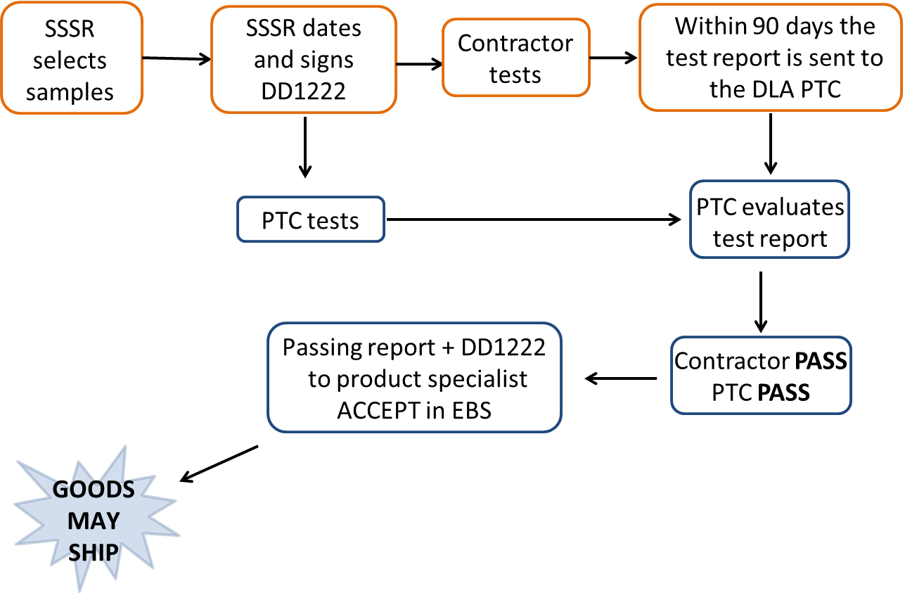
STEST:
Source Sampling Tested

Slide 38
STEST:
Source Sampling Tested
SSSR selects samples
SSSR signs and dates DD1222
Within 90 days the test report is sent to the DLA PTC
Contractor tests
PTC tests
PTC evaluates test report
PTC generates DL6004
Contractor PASS
PTC FAIL
GOODS MAY SHIP
Failing report +
DL6004 to C&T
for information ONLY
ACCEPT in EBS

Slide 39
STEST:
Source Sampling Tested
SSSR selects samples
SSSR signs and dates DD1222
Within 90 days the test report is sent to the DLA PTC
Contractor tests
PTC tests
PTC evaluates test report
Contractor FAIL
PTC PASS
Contractor FAIL
PTC FAIL
Failing report +
DL6004 to C&T
REJECT in EBS
PTC generates DL6004

Slide 40
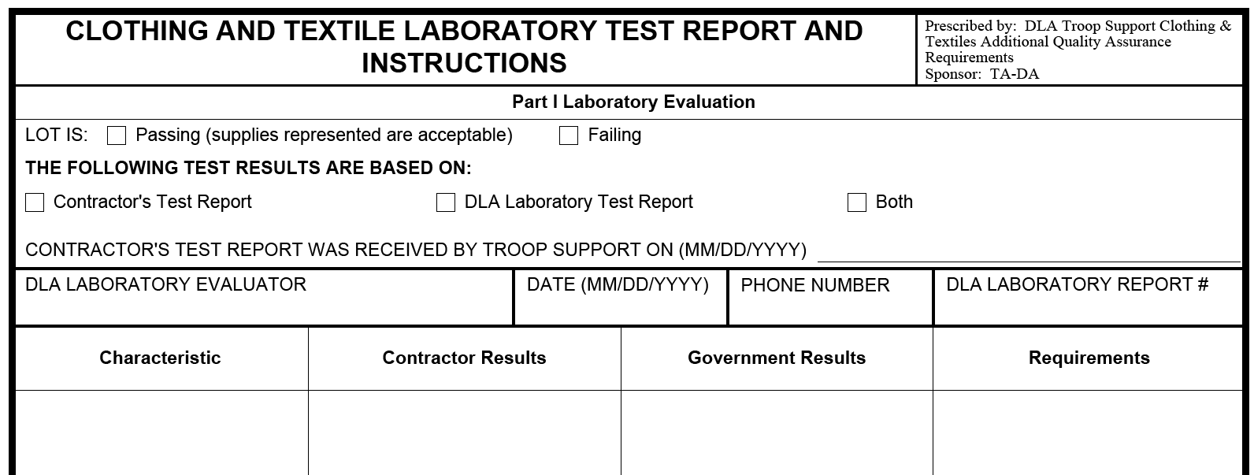
DL6004 and Failures
Summary of the pertinent information needed for a usage decision or corrective action.
DLA PTC will fill out Part I

Slide 41
Verification Testing
QAS/SSSR selects samples
QAS/SSSR signs then datesDD1222
Contractor tests
Contractor PASS/FAIL
PTC PASS
PTC tests
Passing report
to product specialist
ACCEPT in EBS
C&T evaluates test report

Slide 42
Verification Testing
QAS selects samples
QAS Signs then dates DD1222
Contractor tests
Contractor PASS/FAIL
PTC FAIL
PTC tests
Failing report
to product specialist REJECT in EBS
C&T generates DL6004
C&T evaluates test report

Slide 43
Summary
STest: Source Sampling Tested
Verification Testing
PTC requests material
PTC determines tests to perform
PTC evaluation is for guidance
Can ship at own risk whenever
PTC generates any DL6004s
Contractor’s report used for ACCEPT/REJECT
Product Specialist requests material
Product Specialist decides tests to perform – can test all or only specific characteristics
PTC evaluation is for acceptance
CANNOT SHIP until PTC results are in
Product Specialist generates any DL6004s
PTC’s report used for ACCEPT/REJECT

Slide 44
The Future
Currently the source program is reliant on a “paper-based” system using email and faxed submittals using various electronic formats or hand-written forms. Current processes also rely on manual review and sign off steps.
New technologies offer great efficiencies for suppliers, labs, and PTC to automate procedures, enabling consistent data forms and reports.
DLA is adapting a commercially available technology for our needs, transitioning from a manual review process to an electronic, data driven process.
This effort will enable DLA Troop Support to:
  strengthen its partnership and communication with the Clothing & Textile industrial base, and
  increase the visibility of material and end item quality requirements.
As a result, DLA Troop Support and its industrial base will increase its capability to deliver the highest quality clothing and individual equipment items to the warfighter.
Notes:
Technology has moved forward and like technology we must also move forward. 15 years ago we still used typed DD1222’s and snail mail, in 2004 we moved to email distribution, ad electronic processing,. We are now looking to move to an online submission portal.

Slide 45
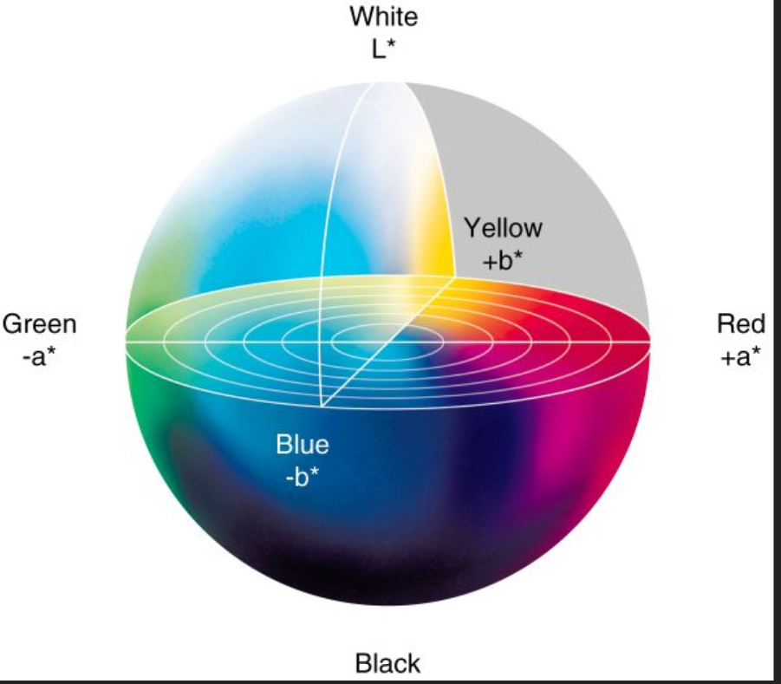
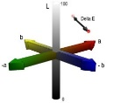
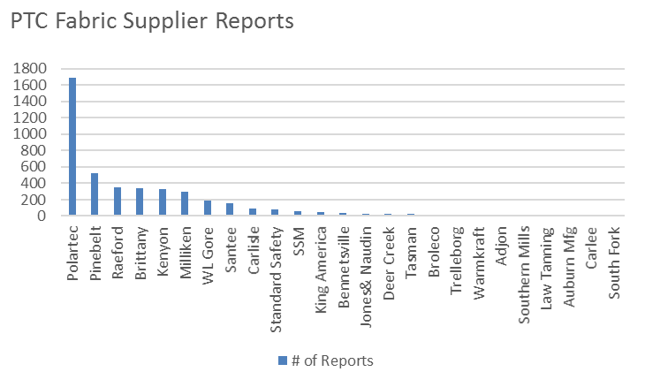
Product Test Center — Analytical
Recent Annual Statistics
~ 15K Test Reports /year
Collaborative Partners: LMI, Texbase, Natific, Major Fabric Suppliers
DLA Sponsor: DLA MUST Program and DLA Product Test Center - Analytical
~10K Shade
~5K Source/Correlation/ Verification Testing
>4K Fabric
< 1K Other
Benefits:
Automated identification of non-conforming material
Standardized process and formats for test result submittal
Higher quality C&T products for the warfighter
Technical Approach:
Reengineer processes, develop protocols
Leverage/validate adopted commercial procedures for proper communication and management of product test data
Identify, tailor and validate COTS software for PTC application
Purpose:
Reengineer and automate manufacturers’ source production lot test reporting
Streamline DLA PTC review and analysis of test results
Notes:
In the last five years we have seen growth in our work on shade and physical testing, to continue to move our process to a more automated system makes sense.

Slide 46
Description of Automated Solution
The Product Test Center has embarked on a modernization program to streamline processes and update its systems to maintain the quality control of materials used to construct clothing and equipment for today’s warfighter.
The MUST Source Sampling Tool is a commercially available textile testing and supplier collaboration system that has been modified to meet the specific workflow requirements of the DLA supply chain.
The MUST Source Sampling Tool merges Prime Contractors, Material Suppliers and Independent Testing Labs into one standardized system.
Notes:
The companies we are working with has may years of experience, and a COTS system that will work, with some modifications. Will allow the PTC to streamline the lot notification process, it will automatically generated DD1222’s, electronic sign off capability, ad the system has taken into account the potential loss of DCMA QARS into consideration. The system will automatically notify the PTC when reports are ready, we see this as both a work and time saver.

Slide 47
Intro to Source Sampling Tool
Easy to use browser-based system (no software to install)
Benefits include:
  Standardized workflow
  Standardized testing procedures
  Digitizing data
  Automated notification and PTC response of source lot testing date/enforcement of 14 day waiting period
  Visibility to current testing requirements
  Automatic evaluation of test results versus test requirements
  Ability to re-use previously entered data
  Automated creation and archiving of standard DD1222
  Automated event notifications for all members of the supply chain
Notes:
Our goal is to have an easy user driven system that expedites the source sampling process.

Slide 48
Challenges to Overcome
Resistance to change
  Current DLA process is inefficient and needs to change
  Suppliers individually optimized
Fear of the unknown
  Education on the use of the tool
Dual Entry
  Understand how the tool works and see how it can reduce the work currently being done
Concern for increased oversight
  Streamlined processes equate to reduced costs and increased quality
Notes:
We have become comfortable even if at times frustrated with the current system. Change is difficult, as we move into the process active participation will help quell fears, and provide better understanding. We are looking to increase speed of processing, not level of oversite.

Slide 49
Source Sampling Tool Roll-Out
Continue Final Phase of Development
On-board fabric suppliers in phases to submit all fabric reports through the system
Focus on high volume fabric suppliers
When on-boarding the fabric suppliers, include their associated primes
Considerations for timing supplier on-boarding
  Past engagement with Source Sampling Tool User Eval
  Past engagement with R&D/PTC efforts
  Stability
PTC will contact participants prior to on-boarding coordination
Notes:
Do not be alarmed, if you are part of the initial rollout the PTC will contact you. We’d like you to know this is coming, and will update the entire system

Slide 50
PTC POC’s
Jamie Hieber
Lab Manager
Jamie.Hieber@dla.mil
215-737-3241 (Office)
215-687-7037 (Work Cell)
Jessica Raushel
Supervisory Chemist
Jessica.Raushel@dla.mil
215-737-3246 (Office)
267-236-3779 ( Work Cell)
Uraina Gray-Scully
Supervisory Chemist
Uraina.Gray-scully@dla.mil
215-737-3265 (Office)
(267) 990-4093 (Work Cell)
Myriam Cuadra
Test Coordinator
Myriam.Cuadra@dla.mil
215-737-3298 (Office)

Slide 51
Questions?

